Slide 1
Local Carbon Oxford Project (LCOP)
City Council in partnership with Low Carbon Hub, supported by Oxford Brookes University's Environmental Information Exchange/ Energy Solutions Oxfordshire (ESOx)
Innovation project – grant funded by Innovate UK until 30 June 2025

Slide 2
The challenges
For Oxford: To hit its target of Net Zero by 2040, organisations and businesses of all types and sizes across the city need to be involved in the transition.
For energy efficiency: The amount of money needed for non-domestic retrofit is estimated at £478 million in Oxford alone¹.
For business: Organisations who want to support climate action often do so by funding carbon projects (carbon crediting) that are distant and intangible.
For credibility: Carbon credit markets are unregulated and have no standardisation (recent issues of "greenwashing") we can do better locally.
¹ Estimate based on data from Energy Solutions Oxfordshire.
Notes:
International VCM is a wild west, hugely varying validation and verification methodologies, many different approaches to accreditation, different definitions and language etc
Carbon crediting requires stringent validation and verification which is hugely expensive and time consuming, a significant long term commitment, very expensive and laborious to become accredited to verify to international standard and potentially beyond the scope of what a local authority can do; international standards only achievable at significant scale potentially beyond limit of what is achievable locally
Ethical and moral challenges around offsetting more generally, potential issues both intrinsically for district projects and extrinsically being associated with offsetting as a brand
Best practice is rapidly evolving and moving and might move away from offsetting completely by the time an accredited project is up and running

Slide 3
Key Objectives
To break down finance barrier for SMEs looking to do non-domestic retrofit.
To support progress towards net zero Oxford 2040.
To keep funding local – benefiting local organisations and local communities.

Slide 4
What is Local Carbon Oxford?
New scheme supporting local projects in Oxford that reduce carbon and improve community prosperity.
Supports SMEs, charities and community groups to deliver vital energy efficiency works.
Matchmaking process pairs local organisations in need of funding with businesses keen to contribute funding to support community and climate action.
Rigorous accreditation by the Council to ensure funded measures deliver real, local and tangible action on decarbonisation.
Innovation project – OCC is grant funded by Innovate UK until June '25 to develop and pilot this new process.

Slide 5
How it works
Energy efficiency project applies to LCOP
Project and Funder match found
Energy efficiency measures installed
Central Register records projects and funders
✔️ Certificates issued
Tripartite funding agreement signed
LCOP verifies install
Prospective funder applies to LCOP

Slide 6
Its not carbon credits, its "Beyond Value Chain Mitigation"/ CSR focussed
“Companies should take action or make investments outside their own value chains to reduce or remove GHG emissions in addition to their near-term and long-term science-based targets.”
Science Based Targets initiative (SBTi) Corporate Net Zero Standard on Beyond Value Chain Mitigation (BVCM)

Slide 7
Contribution, not attribution
Approaches vary:
🏭 Offsetting 110% of emissions
🛫 External emissions inventories
🏷️ Internal carbon pricing
Benefits of BVCM:
🌲 Prioritises benefits for people and nature
💵 Reduces issues of price competitiveness; quality over quantity
🚅 Direction of travel for best practice
🧘 Potentially increased flexibility around validation and verification
🗣️ Positive shift in language
Notes:
SBTi concept stating companies should contribute to emissions reduction outside their own value chain – either through supporting projects or buying and retiring credits
Potential approaches include: Offsetting 110% (e.g. Oxa), external emissions inventory, internal carbon price that raises funds for BVCM; major focus on co-benefits for people and nature
Reduces issue of price competitiveness because buyers looking for quality rather than quantity
Direction of travel for best practice – “contribution rather than attribution”
Potentially reduces need for adhering to international VCM standards
Language is shifting to one of “contributions” rather than “credit purchases”

Slide 8
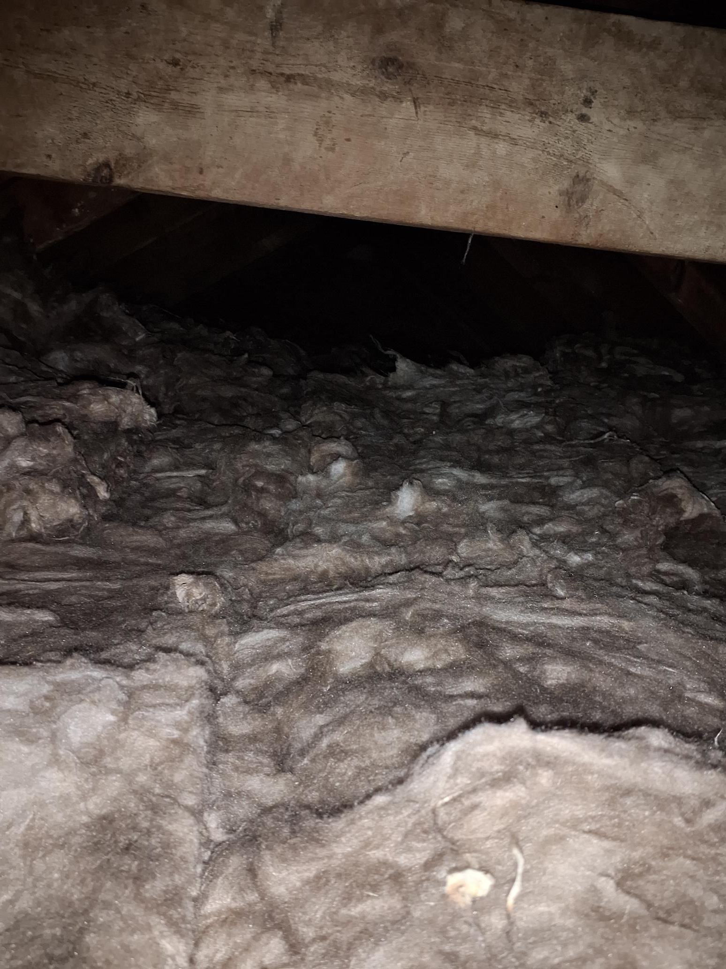
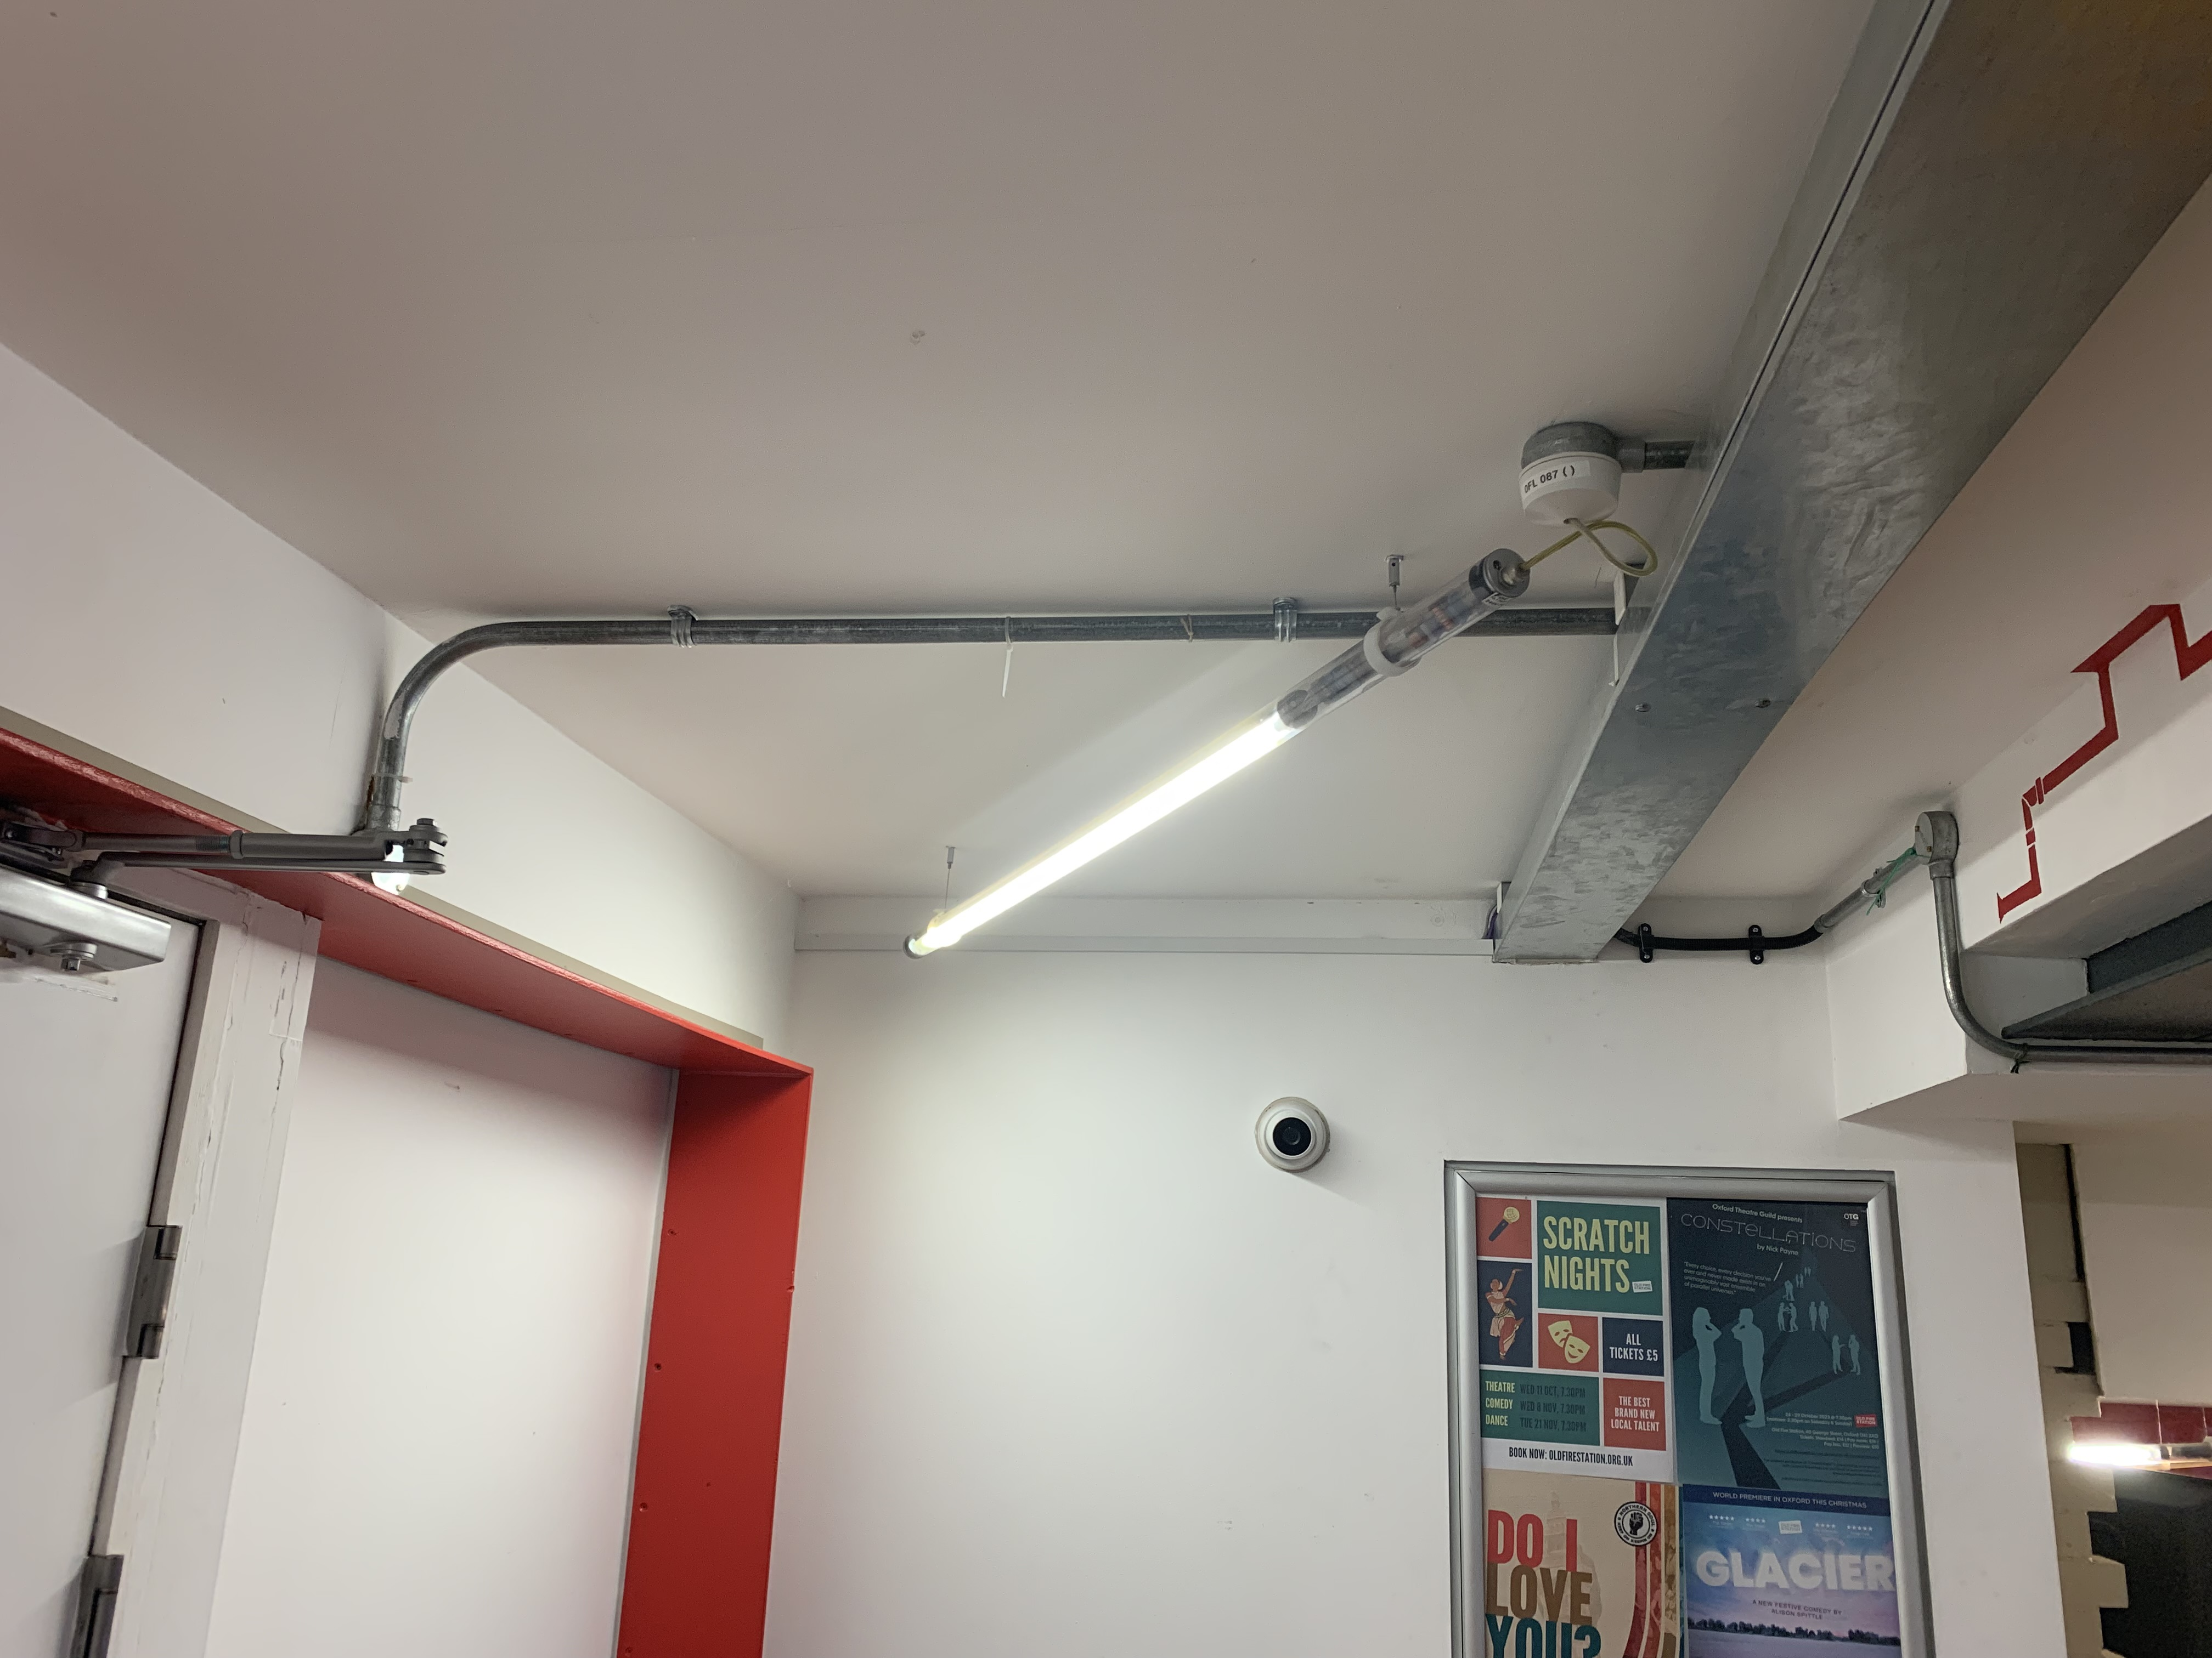
What's in scope?
Project must be in Oxford and a non-domestic building.
Funders must have a connection with Oxfordshire.
“Traditional” energy efficiency measures funded (because the innovative bit of this project is the "matchmaking process")
Insulation, heating controls, lighting, solar panels, heat pumps – and more, providing we can robustly validate proposed carbon savings.

Slide 9
Progress & impact to date
Approx £200,000 3rd party funding potential identified so far, of which £9,800 secured and already spent locally.
Match funding by retrofit project is encouraged, which would increase the impact value.
5 local organisations either applied to fund or very interested in providing funding.
10 organisations applied/started application to receive funding.
Further 14 organisations engaged and interested.
3 case study projects completed to test scheme design.
Innovate UK very interested – filmed the project for one of c.5 case studies out of a funded cohort of 50+ Local Authorities.

Slide 10
What next?
Innovate UK funding ends June 2025.
Currently investigating resourcing for continuing the pilot.
OCC will need to support energy efficiency projects that have reached a funders contract agreement prior to 30th June, but where implementation of the work may run on.
Opportunities to build on scheme by linking with the emerging Local Plan requirement around carbon "insetting".
Opportunities to improve by widening scope of scheme (e.g. types of energy projects accepted).
Innovate UK and DESNEZ are still awaiting their funding review, so follow-on grant funding in this space is still unknown.
DESNEZ are interested in data/ insights from the project to contribute towards national retrofit policy.

Slide 11
Any Questions? LCOP@oxford.gov.uk

